Slide 1

Competitive Cyber Security Organization
General - Cryptography
Attendance code:
By attending today’s meeting you acknowledge that you may be photographed or recorded for club use

Slide 2
Learning Objectives:
What is Encryption, Hashing, and Steganography
How does HTTPS work?
Are my encrypted files safe?
How do hackers crack passwords
How malware communicates undetected

Slide 3
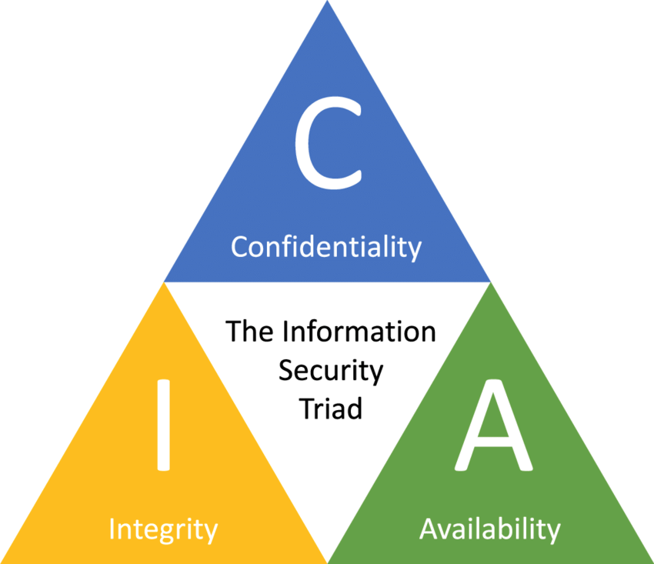
Cryptography & CIA Triad
What is cryptography?
Method of protecting information through algorithms
Fulfill one or more criteria of the CIA Triad
CONFIDENTIALITY, INTEGRITY, and AVAILABILITY of data
Confidentiality: Only intended parties can read data
Integrity: Ensure data was unchanged/ uncorrupted
Availability: Authorized users are able to access data

Slide 4

Cryptographic Techniques
Encryption
Protect contents of message
Hashing
Create fingerprint of message
Steganography
Hide transmission of message

Slide 5
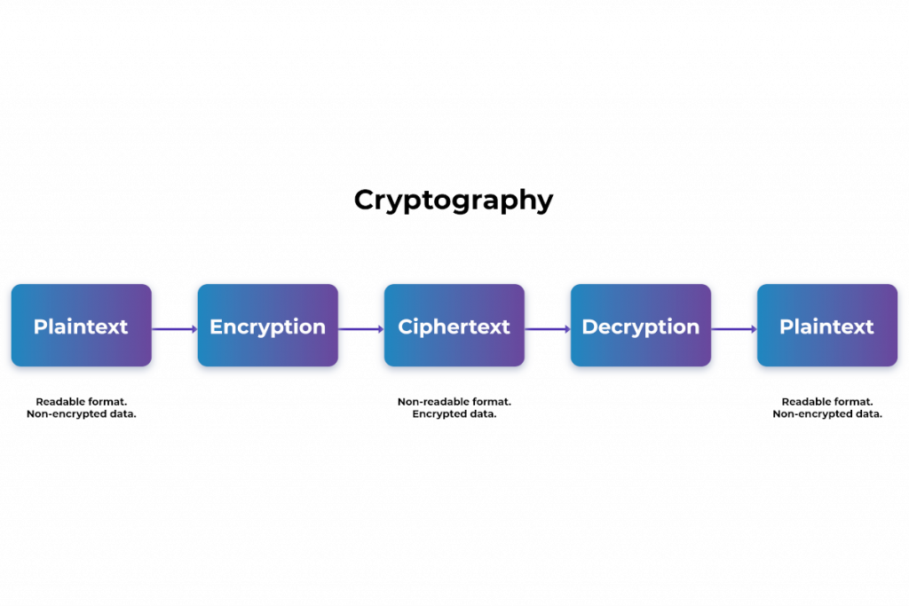
Encryption
Obfuscating content of message
Aware of communication, unaware of contents
Historic example:
Caesar Cipher, Enigma

Slide 6
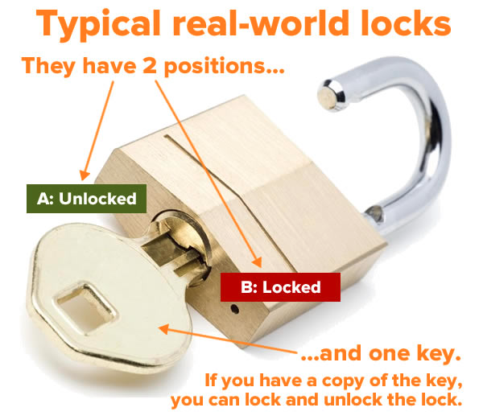
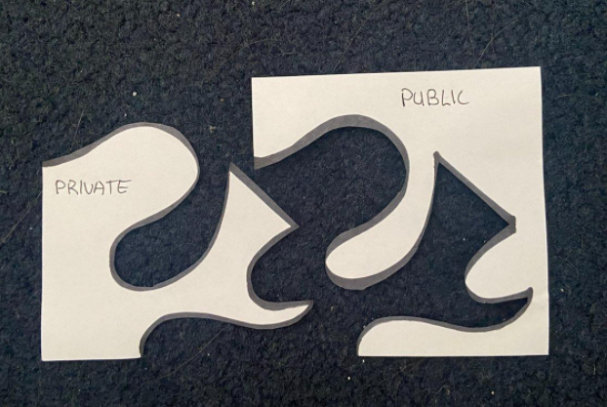
Symmetric vs Asymmetric Encryption
Symmetric keys:
Single key, shared between all parties
Faster, but less secure
Asymmetric keys:
Each party has a private key and public key
Slower, but harder to crack

Slide 7
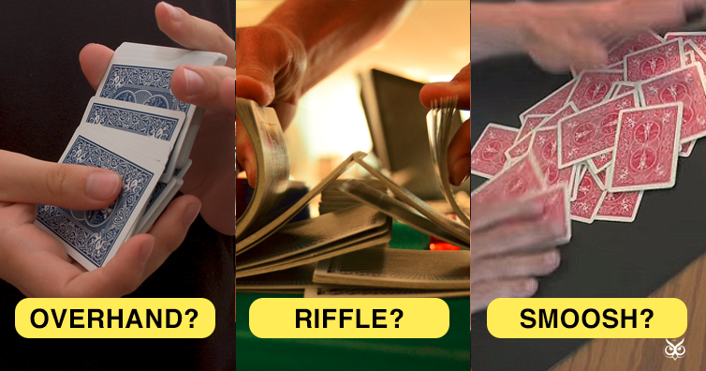
Ciphers
An algorithm used to perform encryption or decryption

Slide 8
Easy Symmetric Encryption:
How did I encode the following?
“Hello World!” -> “Khoor Zruog!”
This is a Shift (ROT) Cipher, because the letters are shifted (rotated) by a number of positions in the alphabet
This shift is the key

Slide 9
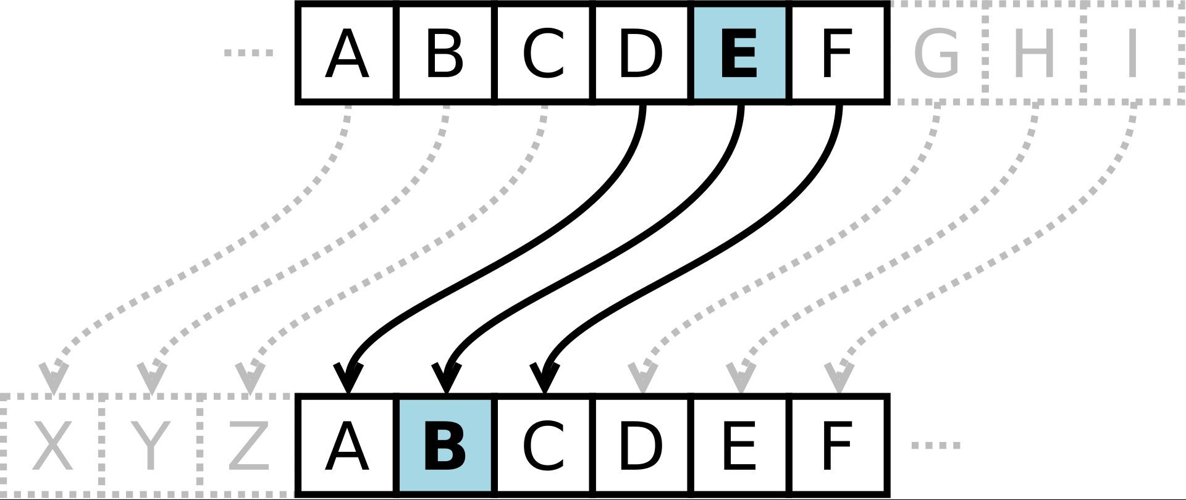
Symmetric Encryption: Shift Ciphers
Characters are shifted by predetermined amount
Amount is the key (ex: 2, 3, 25)
To decrypt, we shift them back
Common examples: Caesar Cipher (ROT-3, ROT-13)
Simple, but still used in larger cipher methods
(EX: Vigenere cipher)
Issues:
Brute Forcing
Frequency analysis

Slide 10
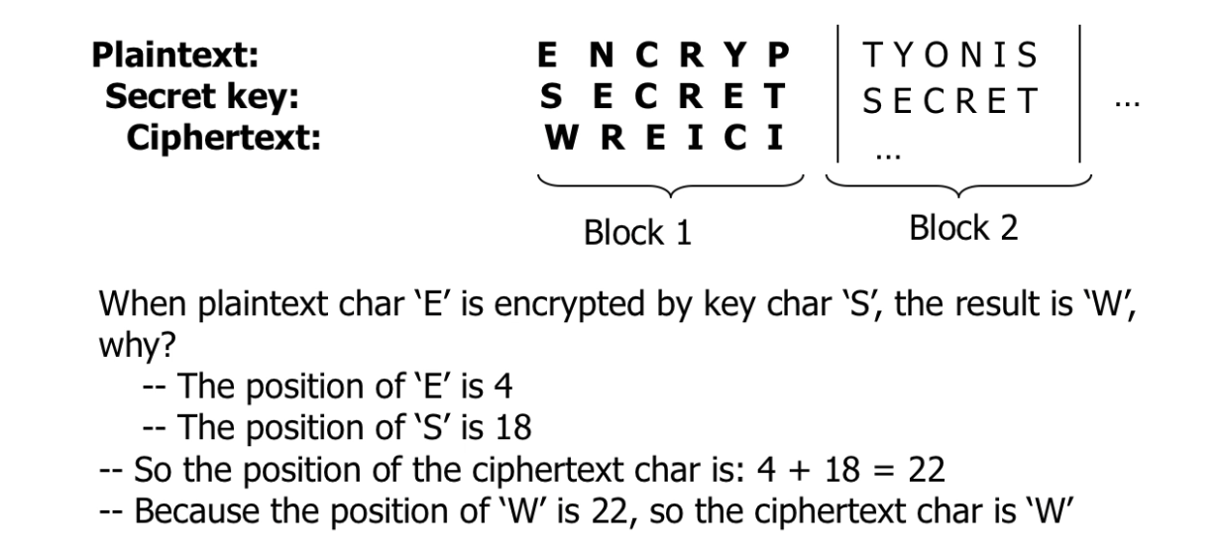
Symmetric Encryption: Block Ciphers
Plaintext split into blocks
Same length as key
Each block encrypted & decrypted
With same key
Blocks concatenated to form ciphertext/plaintext
Different ciphers have different block sizes
128 or 256 bits
Must correspond with key size
Time Intensive

Slide 11
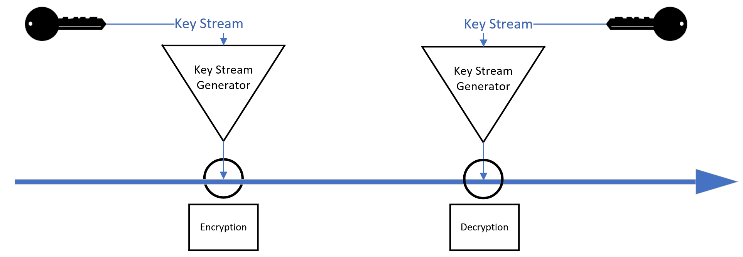
Symmetric Encryption: Stream Cipher
Plaintext is fed as a “stream”
One character encrypted at a time
Key used to initialize pRNG (Initialization Vector)
Faster, simpler to code

Slide 12
Cipher Name | Example Use Area | Type
3DES | Electronic Payments | Block
AES-256 | Encrypted .zip Files | Block
AES-128 | iMessages | Block
RC4 | Microsoft Office | Stream
ChaCha | TLS | Stream
E0 | Bluetooth | Stream

Slide 13
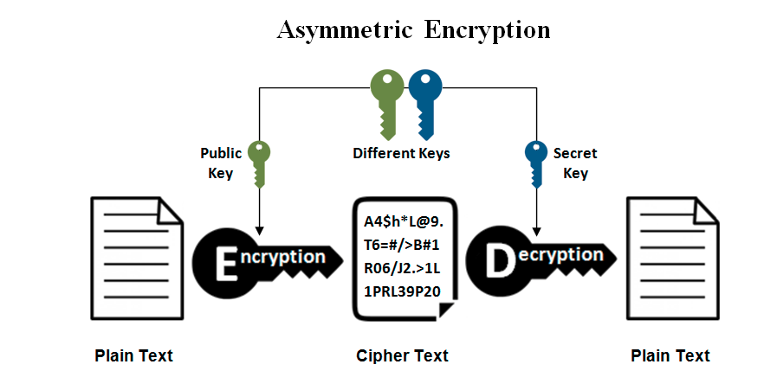
Asymmetric Encryption
Two keys: public and private
Public key: shared with everyone
Private key: protect with your life
Only you could have sent a message
Only you can read a response

Slide 14
Asymmetric Encryption: How work’s???
Math is hard! Big numbers & prime numbers scawwy
Why is it secure?
Easy to multiply two prime numbers together
Harder to guess the two prime factors of a product
Example:
What is 907 x 773
What are the factors for 49,193,171

Slide 15
Ransomware
“Blah blah files locked blah blah blah ransom blah blah blah decryption key blah blah bitcoin”
Typically an Asymmetric Encryption algorithm

Slide 16


Three Cup Monte
Notes:
Jameswell

Slide 17
Notes:
Jameswell

Slide 18
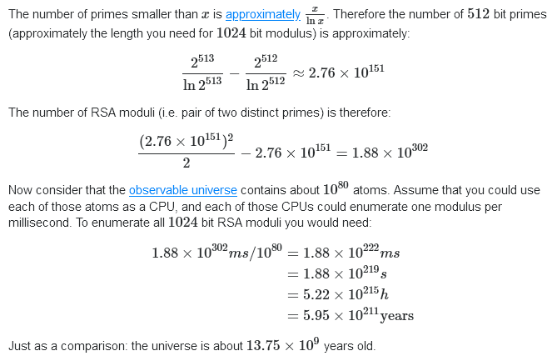
How long would it take to brute force RSA
Notes:
Jameswell

Slide 19
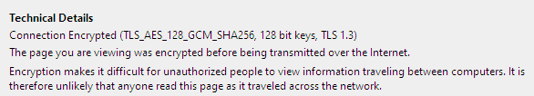
Modern Day Encryption
Advanced Encryption Standard (AES)
Symmetric - 1 key
WiFi, browsers, VPN’s, Filesystems
Rivest–Shamir–Adleman (RSA)
Asymmetric
Used to set up symmetric key channels
Check your browser!
Notes:
Jameswell

Slide 20
TLS
AES _ 128_GCM
128 Bit Keys
SHA256
TLS 1.3
Use “Transport Layer Security” to secure the communication channel.
Use the AES cipher, use 128 bit long blocks, and use the cipher in Galois/Counter mode (as a stream cipher)
The key will be 128 bits long
Use SHA256 as our hashing algorithm
The version of TLS is 1.3
Notes:
Jameswell

Slide 21
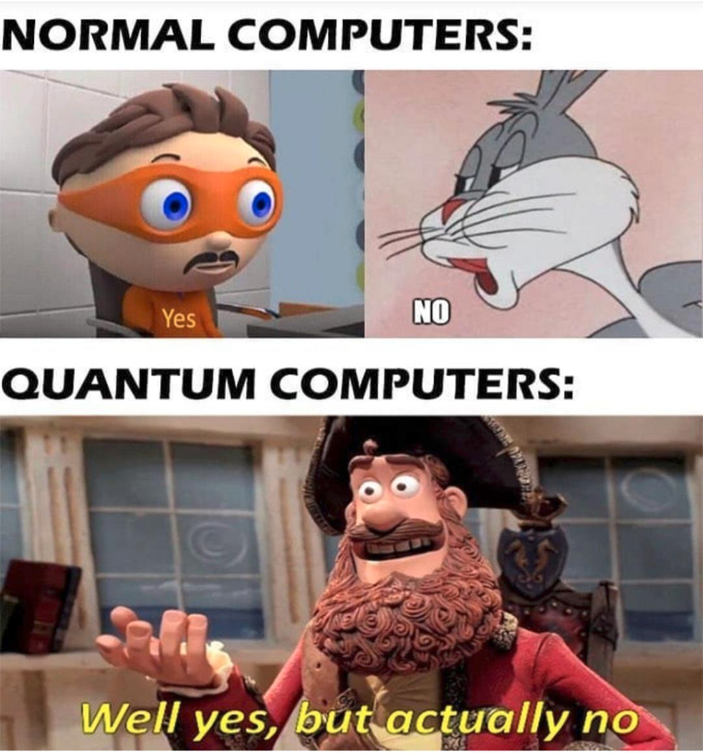
Quantum Computing & Encryption
Encryption algorithms are strong if attacks are too computationally expensive.
Ex: hacker dies of old age before plaintext found
Humans < computers < quantum computers
Keywords: “Lattice cryptography”
“Shor’s Algorithm”
“Grover’s Search”
Notes:
Jameswell

Slide 22
Encryption Takeaways
Protects message contents
Symmetric and Asymmetric ciphers
One key is simple
Prime numbers are hard
Notes:
Jenna

Slide 23
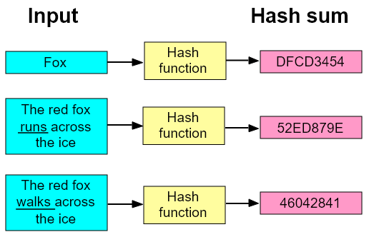
Hashing
Turns input into unique gibberish
Unique identifier for the input

Slide 24
What makes a good hash function?
Key characteristics:
One-Way
Cannot determine input from hash value
Diffusion
“Avalanche effect”
Deterministic
Re-calculating the hash yields same result
Notes:
Jameswell

Slide 25

Hashing Applications
Modern hashing uses: 1.) Storing passwords securely
2.) Checking data integrity
3.) Fingerprinting Malware
Notes:
Jameswell

Slide 26
Hashing time!
What’s the md5 hash for:
cryptography
A. ) 84045dd72657fdcdda1a10929e3fde11
B. ) f08d9945c1075112b57c8e9aba5afbd4
C. ) e0d00b9f337d357c6faa2f8ceae4a60d
D. ) f2d6cfe7c8cfba7503592a8155b515e7
Notes:
Jameswell

Slide 27
Password Attacks
Dictionary Attack:
Calculate the hash value of all possible inputs in a “dictionary”.
See which input gives the same target hash.
Rainbow Table Attack:
Collection of hashes and their input
Allows attackers to “match up” a password hash and the original password
Brute Force Attack
Try every combination until correct input is found.
Notes:
Jameswell

Slide 28
Hashing Takeaways
Hashes create a fingerprint of a message
Ensure the integrity of data
Password cracking ~ educated guessing
Notes:
Jameswell

Slide 29
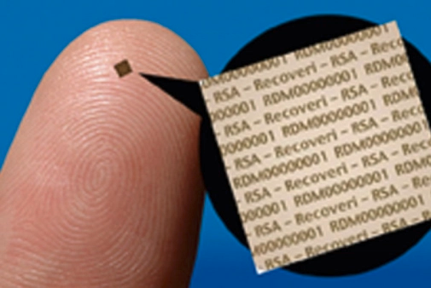

Steganography
We might not know that there IS communication
Historic example:
Microdots
Invisible ink

Slide 30
Steganography
Modern day steganography:
Secret communication
Hidden content in audio files.
Data embedded in pictures
Secret files/ pictures in Word documents
Notes:
Liam

Slide 31
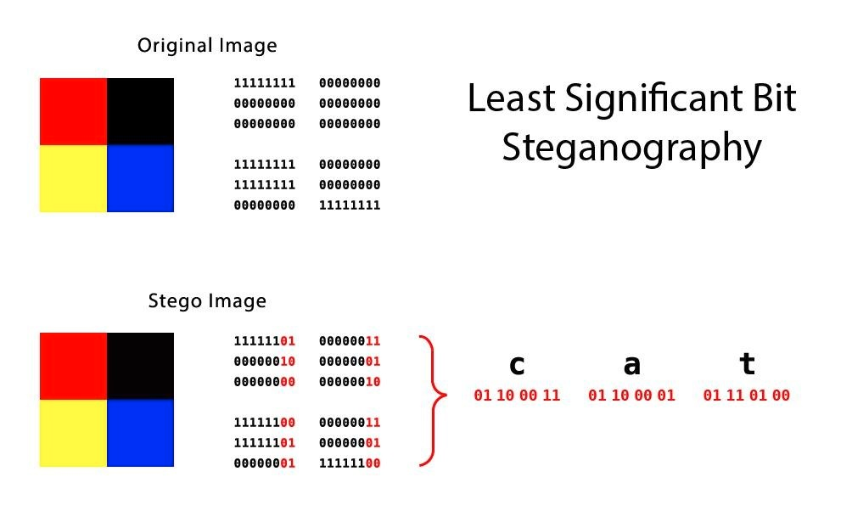
Least Significant Bit (LSB) Steganography
Notes:
Liam

Slide 32
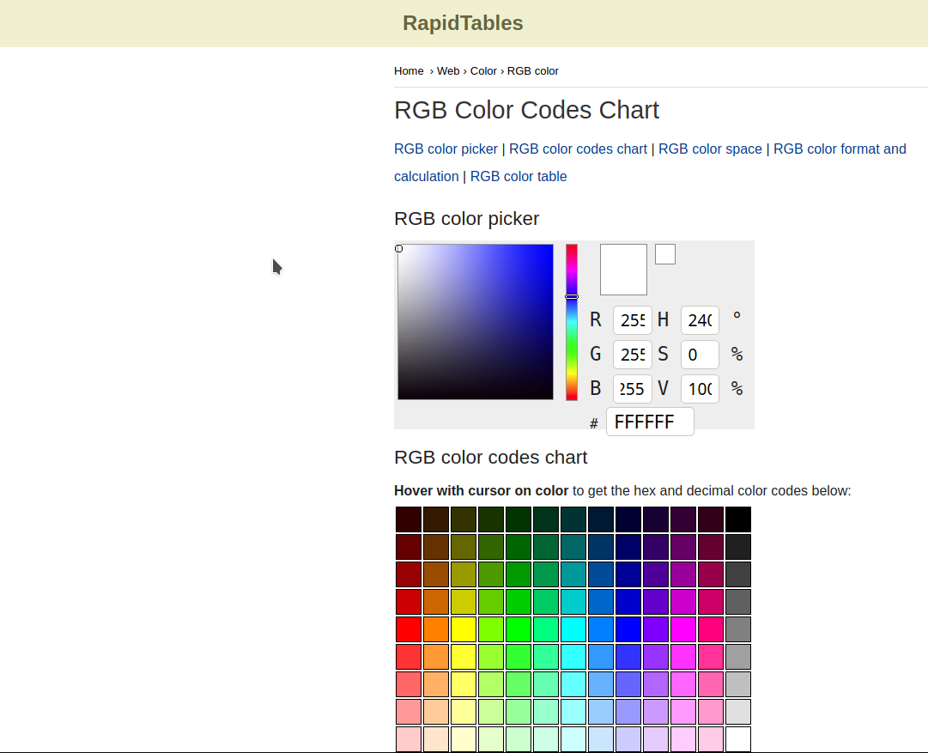
See for yourself! https://www.rapidtables.com/web/color/RGB_Color.html
Notes:
Liam

Slide 33
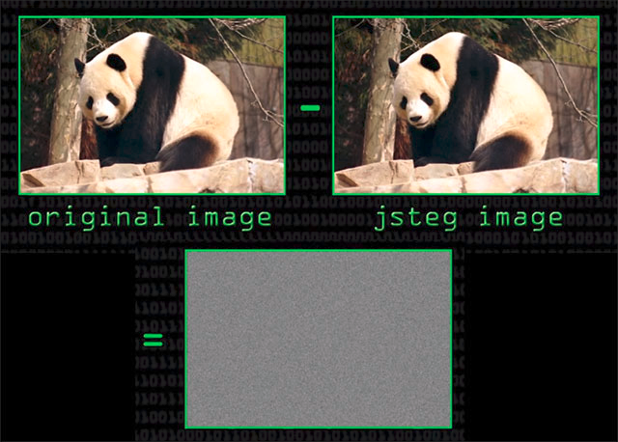
Steganography
Hide traffic for Malware
Duqu, collection of malware, discovered on September 1, 2011
used JPEG steganography to transmit information back to control nodes
Financial information from US DoJ
Notes:
Liam

Slide 34
AdGholas – this malware hides malicious JavaScript in image, text, and HTML files
Cerber – embeds malicious code in image files
DNSChanger – uses PNG LSBs to hide malware AES encryption key
Stegano – PNG formatted banner ads containing malicious code
Stegoloadr (aka ‘Lurk’) – this malware uses both steganography and cryptography to conceal an encrypted URL to deliver later stage payloads
Sundown – white PNG files are used to conceal exploit code or exfiltrate user data
SyncCrypt – ransomware that hides part of its core code in image files
TeslaCrypt – HTML comment tags in an HTTP 404 error page contain C2 server commands
Vawtrak (aka ‘Neverquest’) – hides a URL in the LSBs of favicons in order to download a malicious payload
VeryMal – malware targets macOS users with malicious javascript embedded in white bar
Zbot – appends data to the end of a JPEG file containing hidden data
ZeroT – Chinese malware that uses steganography to hide malware in an image of Britney Spears
Examples of steganography in Malware, as reported by SentinelOne
Notes:
Liam

Slide 35
Audio Steganography
Human hearing between 20 Hz to 20 kHz
20 to 20,000
Most adults have upper range of 15-17kHz
What if data was hidden from 17kHz to 20kHz?
Notes:
Liam

Slide 36
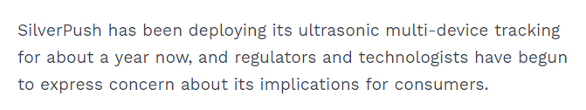
https://www.pindrop.com/blog/the-silent-tracking-beacon-in-your-tv-ads/
Notes:
Liam

Slide 37
Steganography Takeaways:
You can hide data anywhere
Leave no stone unturned… even the obvious ones
Notes:
Liam

Slide 38

CTF Time!

